Slide 1
DHT Sensor and ESP32
Muhammad Teddy Rahmansyah
Natasya Salsabilla

Slide 2
TABLE OF CONTENTS
01
02
Schematic Design
Sketch Code
03
04
Thingspeak Settings
Thingspeak Data Logger

Slide 3
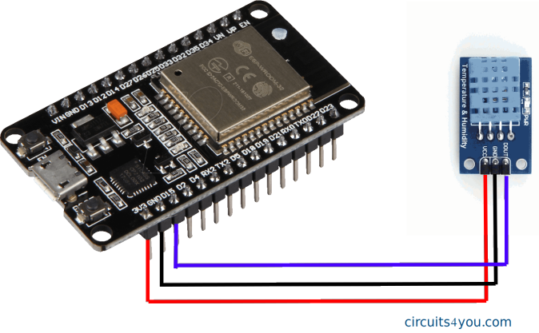
Schematic Design

Slide 4
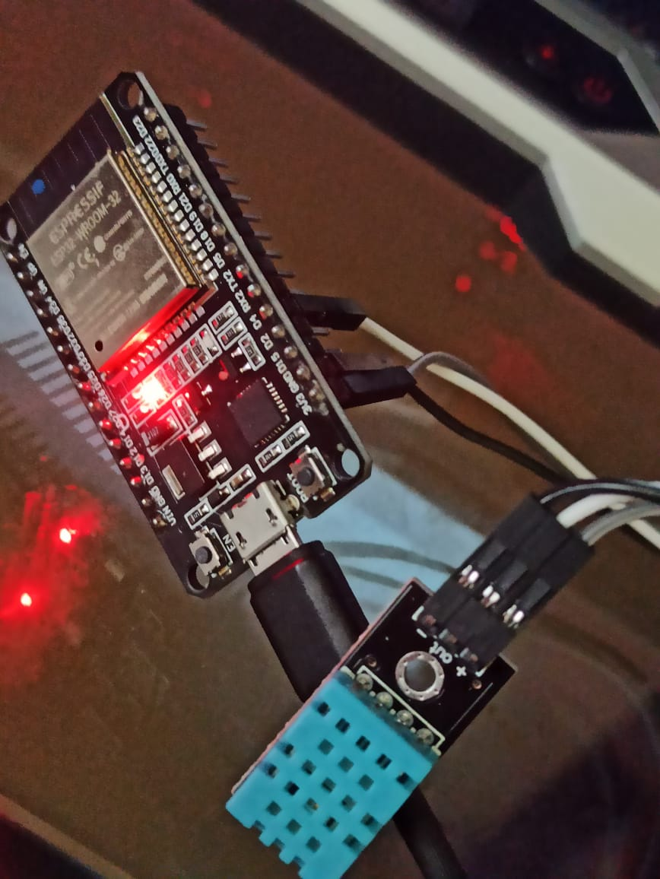

Slide 5
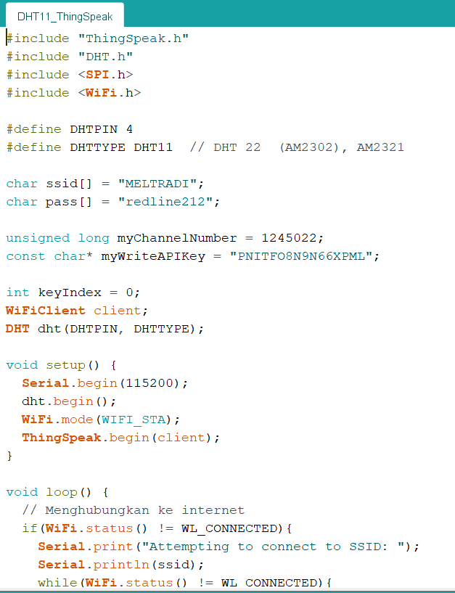
Sketch Code

Slide 6
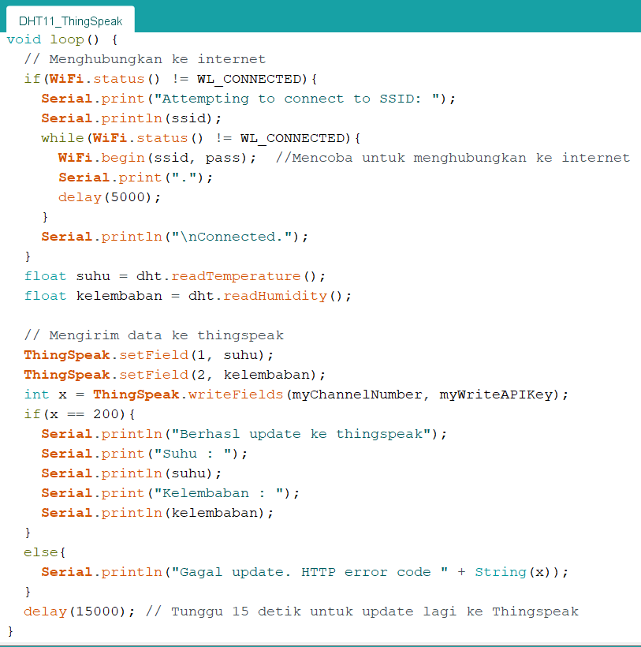
Sketch Code

Slide 7
PROBLEM
Kita Harus memiliki akun thingspeak agar kita dapat membuat Channel Data Logger

Slide 8
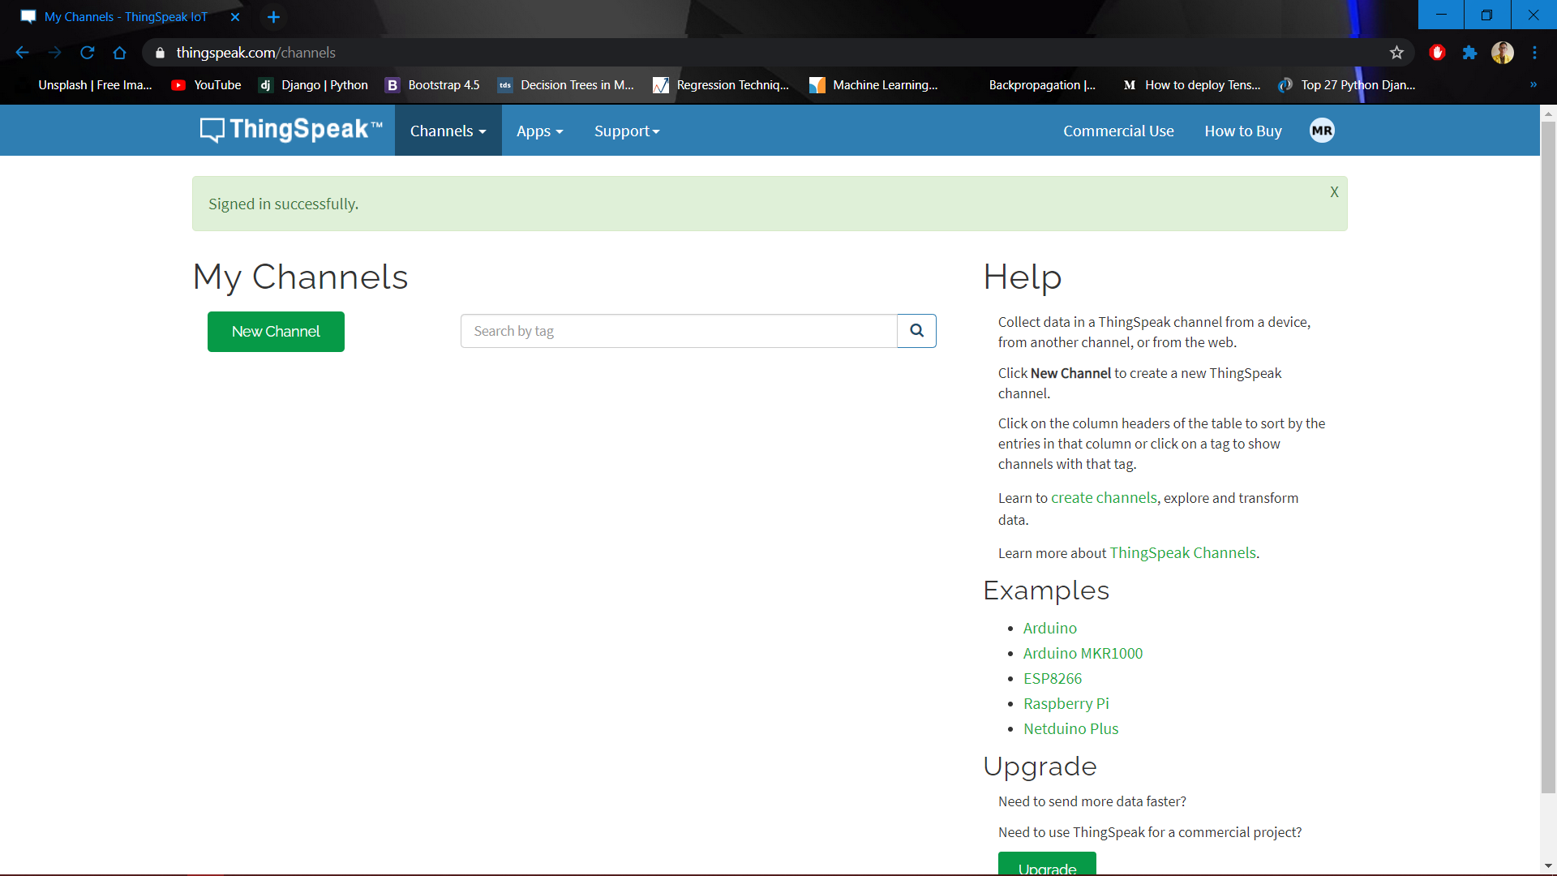
Add New Channel in Thingspeak

Slide 9
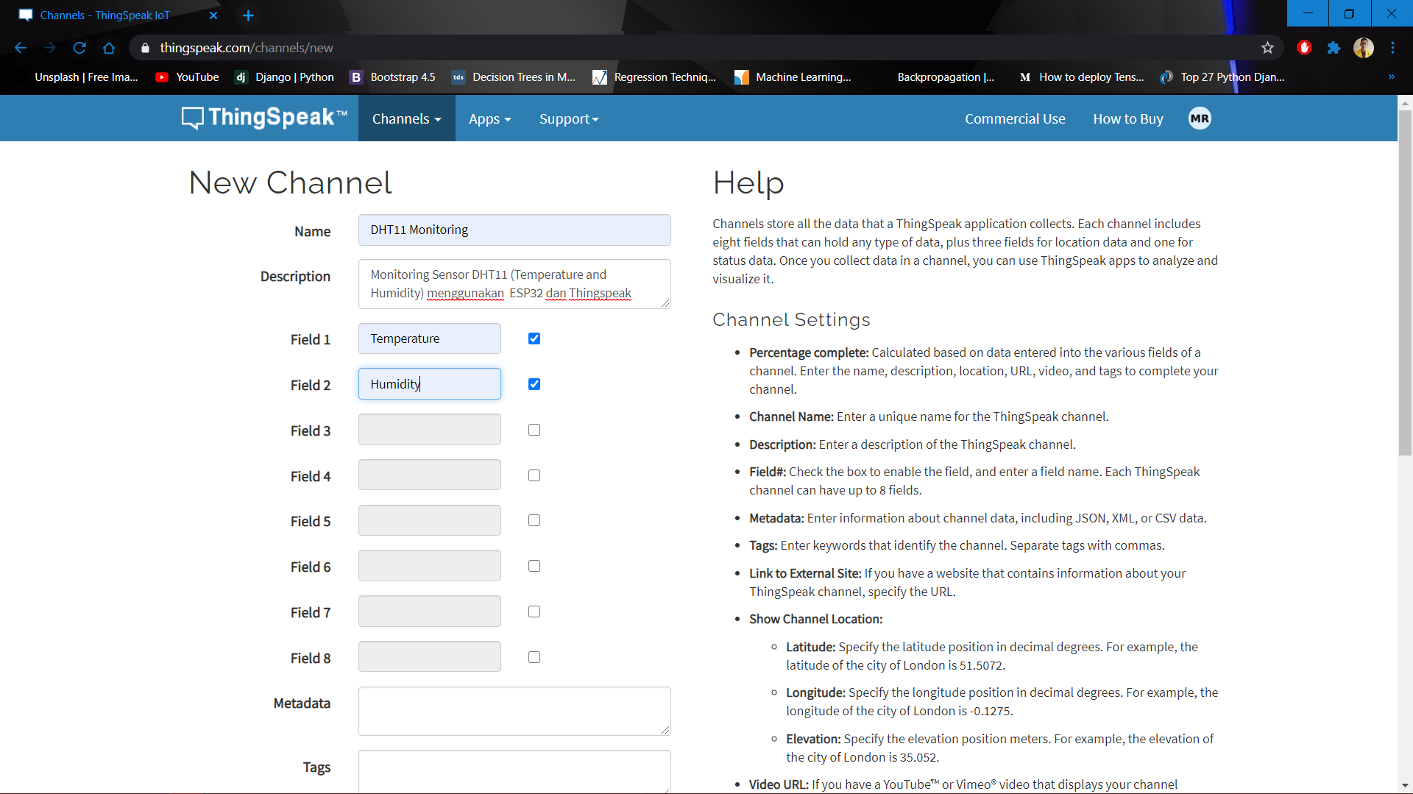
Set the Channel
add the fields ->

Slide 10
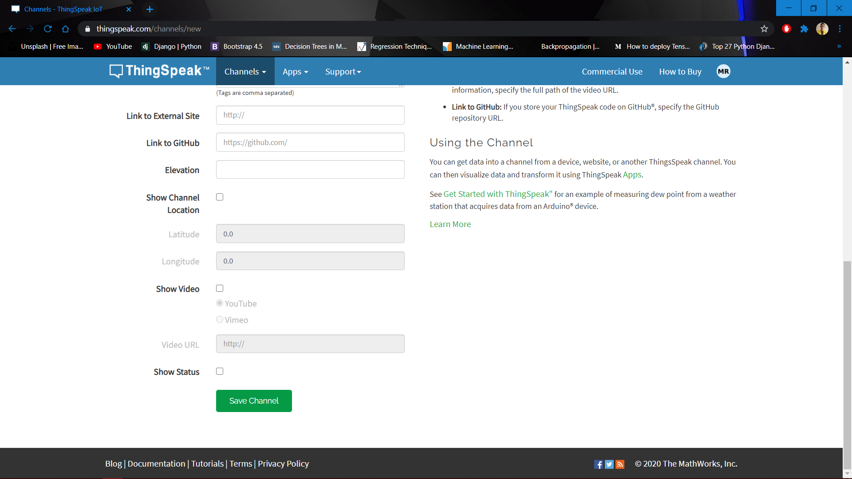
Save the Channel Settings

Slide 11
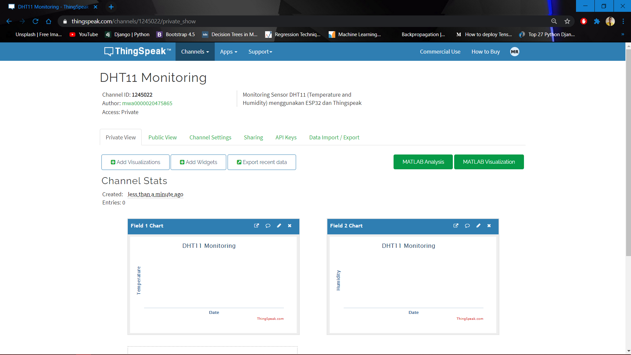
First Look of the Channel

Slide 12
Paste Here
Wifi Name & pass

Slide 13
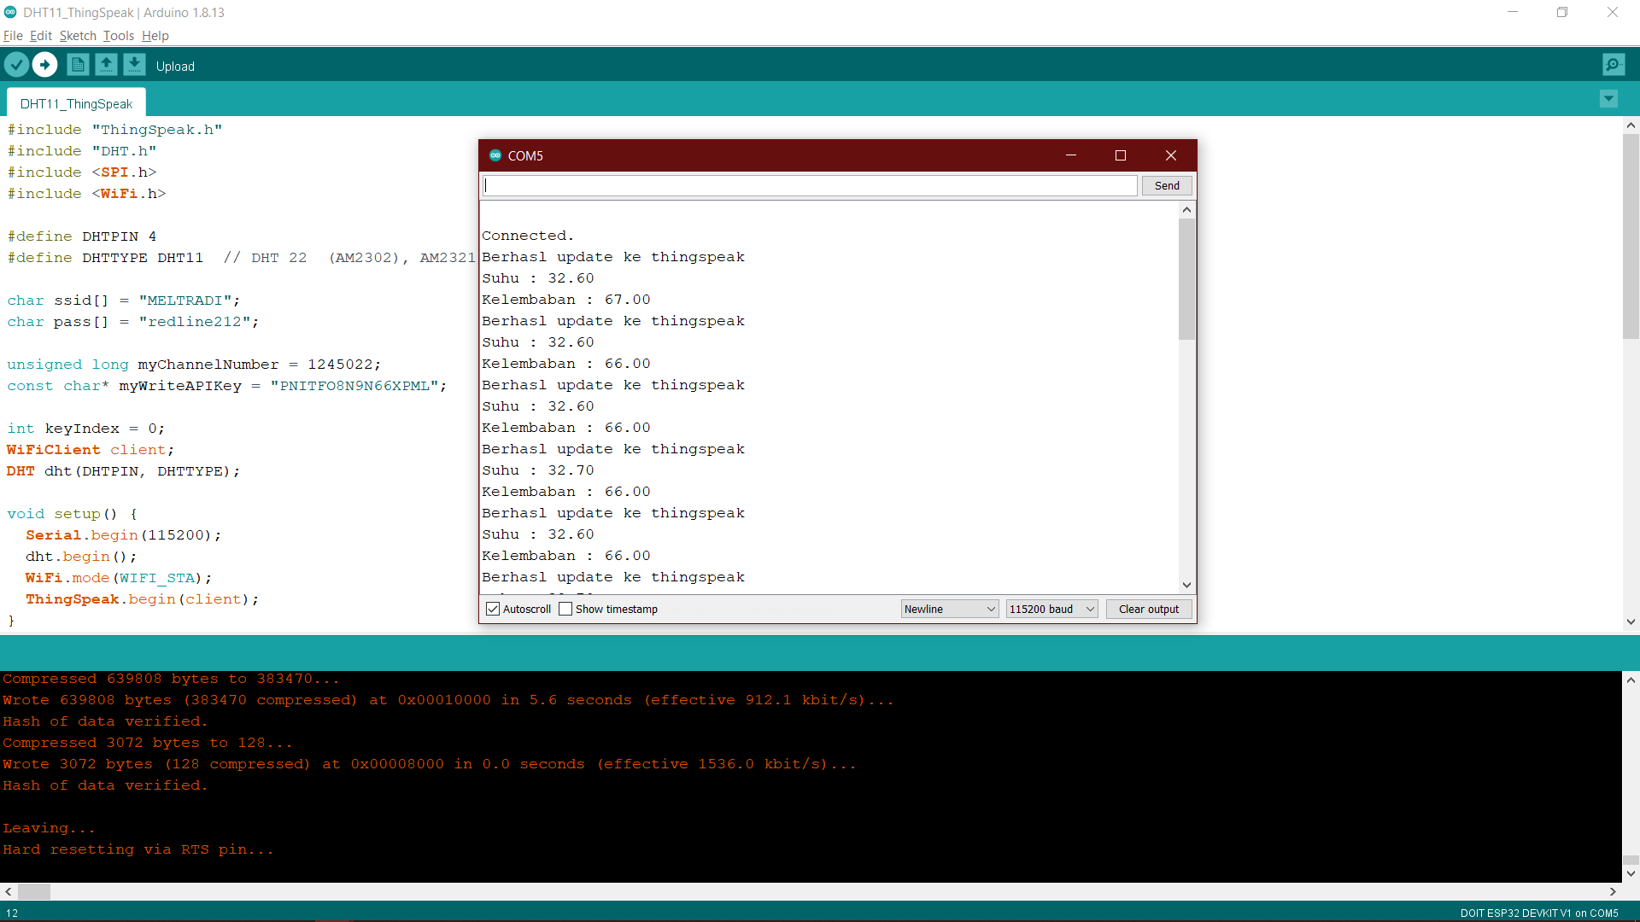
Run and see the Serial Monitor

Slide 14
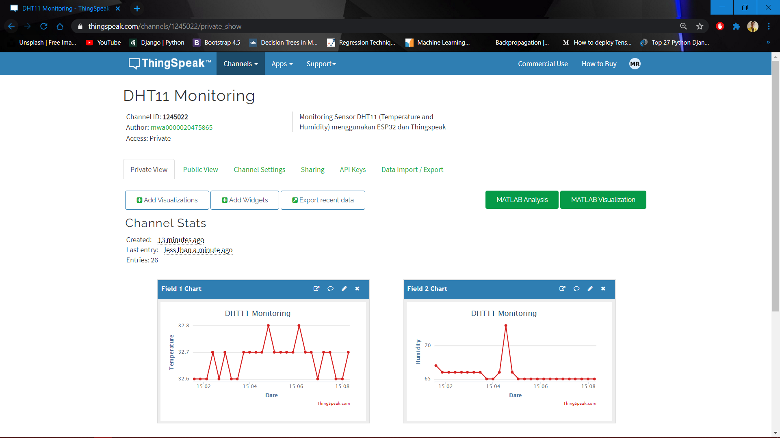
Data Log in Thingspeak

Slide 15
THANKS

